Slide 1


YOUR PARTNER IN SPAIN

Slide 2

Alo Spain DMC
VB Group
CONTENTS
01.
02.
03.
04.
ABOUT US
OUR GOALS
OUR SERVICES
REFERENCES

Slide 3
01
ABOUT US

Slide 4

Alo Spain DMC
VB Group
We are specialized in Incentive and MICE business. We love our country and have developed strong bonds with the best partners over our 15 years of experience in the industry.
Alo Spain DMC, a brand of VB Group
is your partner in Spain.

Slide 5

Alo Spain DMC
VB Group
We aim to provide our clients with the most accurate and creative solutions in accordance with their budget, needs and expectations.

Slide 6
Alo Spain DMC
VB Group
We like to see ourselves as a part
of your team, we are your eyes
and ears in Spain through the event preparation and are available 24/7 onsite during the operation, to guarantee the success of your event.

Slide 7
02
OUR GOALS

Slide 8

Alo Spain DMC
VB Group
Get to know you, understand your needs, customs and expectations
Work with you as a team

Slide 9
Alo Spain DMC
VB Group
Get to know you, understand your needs, customs and expectations
Work with you as a team
Use our know-how and our solid relationship with locals to get the best out of all parts implied in your event

Slide 10
Alo Spain DMC
VB Group
Get to know you, understand your needs, customs and expectations
Work with you as a team
Use our know-how and our solid relationship with locals to get the best out of all parts implied in your event
Make you feel safe and well attended
in all the stages of the preparation
and operation, build trustful connections

Slide 11
Alo Spain DMC
VB Group
Get to know you, understand your needs, customs and expectations
Work with you as a team
Use our know-how and our solid relationship with locals to get the best out of all parts implied in your event
Make you feel safe and well attended
in all the stages of the preparation
and operation, build trustful connections

Slide 12
03
OUR SERVICES

Slide 13
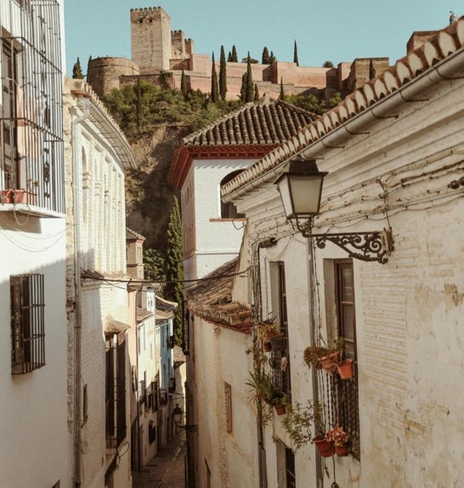
01
02
TRANSPORT
GASTRONOMY
03
04
ENTERTAINMENT
GALA DINNERS
05
ACTIVITIES

Slide 14

01
02
TRANSPORT
GASTRONOMY
03
04
ENTERTAINMENT
GALA DINNERS
05
ACTIVITIES

Slide 15
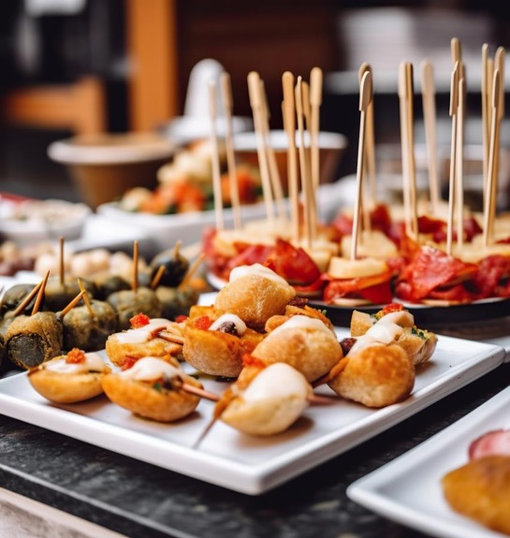
01
02
TRANSPORT
GASTRONOMY
03
04
ENTERTAINMENT
GALA DINNERS
05
ACTIVITIES

Slide 16
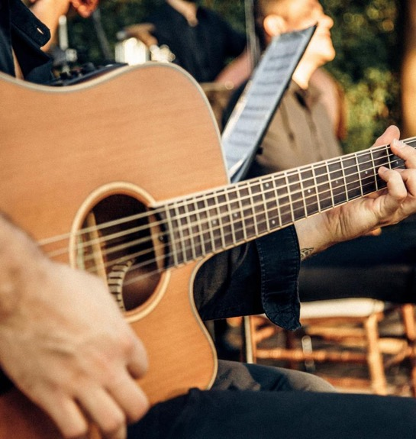
01
02
TRANSPORT
GASTRONOMY
03
04
ENTERTAINMENT
GALA DINNERS
05
ACTIVITIES

Slide 17
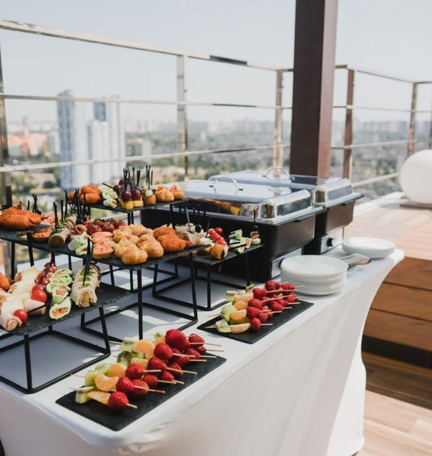
01
02
TRANSPORT
GASTRONOMY
03
04
ENTERTAINMENT
GALA DINNERS
05
ACTIVITIES

Slide 18

01
02
TRANSPORT
GASTRONOMY
03
04
ENTERTAINMENT
GALA DINNERS
05
ACTIVITIES

Slide 19
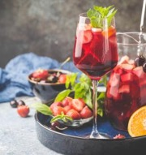




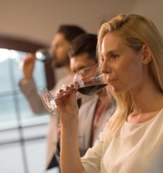
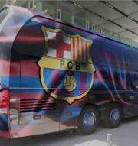
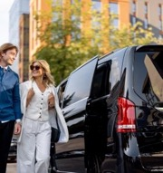
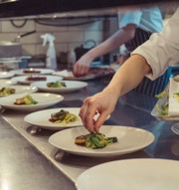
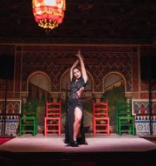
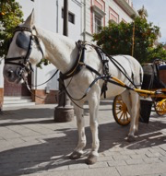
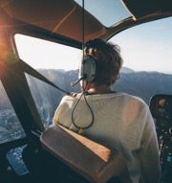
Alo Spain DMC
01
02
03
04
05
PAELLA,
SANGRIA
TAPAS COOKING CLASSES
TAPAS
TOURS
VIP
COACHES
VINTAGE
CARS
TRANSPORT
From the most traditional to the most original and fun, discover our many ways of driving you though Spain.
TRADITIONAL MARKET VISITS
HAM, WINE
OR OLIVE OIL TASTINGS
FC.BARCELONA OFFICIAL COACH
LUXURY SEDANS AND MINIVANS
MICHELIN STAR RESTAURANTS
TRADITIONAL DINNERS
WITH SHOW
ANDALUCIAN HORSE CARRIAGES
HELICOPTER TRANSFERS AND TOURS

Slide 20
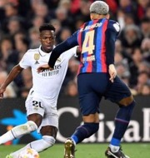





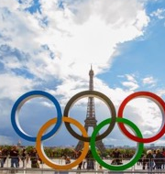
Alo Spain DMC
01
02
03
04
05
SPANISH LEAGUE
CHAMPIONS LEAGUE
PAELLA,
SANGRIA
TAPAS COOKING CLASSES
TAPAS
TOURS
VIP
COACHES
VINTAGE
CARS
GASTRONOMY
We offer a wide range of activities
to discover Spain and its regions through gastronomy.
EURO
2024
CONCERTS
IN SPAIN
AND EUROPE
TRADITIONAL MARKET VISITS
HAM, WINE
OR OLIVE OIL TASTINGS
FC.BARCELONA OFFICIAL COACH
LUXURY SEDANS AND MINIVANS
MUSIC FESTIVALS
PARIS OLYMPICS 2024
MICHELIN STAR RESTAURANTS
TRADITIONAL DINNERS
WITH SHOW
ANDALUCIAN HORSE CARRIAGES
HELICOPTER TRANSFERS AND TOURS

Slide 21
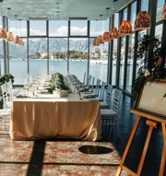

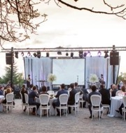
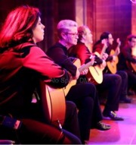
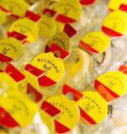
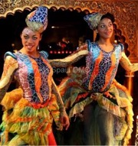
Alo Spain DMC
01
02
03
04
05
VENUE FINDING
DECORATION
SPANISH LEAGUE
CHAMPIONS LEAGUE
PAELLA,
SANGRIA
TAPAS COOKING CLASSES
TAPAS
TOURS
ENTERTAINMENT
We are official authorized agents for the biggest Spanish football clubs
& for Olympics 2024 Paris.
STAGE SET UP
MUSICAL ATMOSPHERE
EURO
2024
CONCERTS
IN SPAIN
AND EUROPE
TRADITIONAL MARKET VISITS
HAM, WINE
OR OLIVE OIL TASTINGS
SOUVENIRS / GIFTS
THEMED PARTIES
MUSIC FESTIVALS
PARIS OLYMPICS 2024
MICHELIN STAR RESTAURANTS
TRADITIONAL DINNERS
WITH SHOW

Slide 22

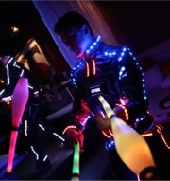
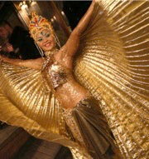
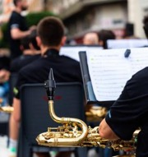


Alo Spain DMC
01
02
03
04
05
BRANDING
ENTERTAINMENT
VENUE FINDING
DECORATION
SPANISH LEAGUE
CHAMPIONS LEAGUE
GALA DINNERS
Our production team and partners take care of all the aspects and details of your event.
DANCE SHOWS
MUSICAL RECEPTION
STAGE SET UP
MUSICAL ATMOSPHERE
EURO
2024
CONCERTS
IN SPAIN
AND EUROPE
LIVE BANDS
RUMBA
AND FLAMENCO PRIVATE SHOWS
SOUVENIRS / GIFTS
THEMED PARTIES
MUSIC FESTIVALS
PARIS OLYMPICS 2024

Slide 23


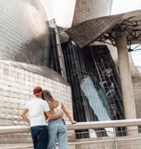


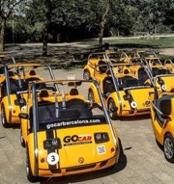
Alo Spain DMC
01
02
03
04
05
FOOTBALL TICKETS
SHOPPING EXCURSIONS
BRANDING
ENTERTAINMENT
VENUE FINDING
DECORATION
GALA DINNERS
Our production team and partners take care of all the aspects and details of your event.
MUSEUM VISITS UNDER CLOSED DOORS
SAILING EXCURSIONS
DANCE SHOWS
MUSICAL RECEPTION
STAGE SET UP
MUSICAL ATMOSPHERE
TEAM BUILDINGS
GO CAR TOURS (TALKING CARS)
LIVE BANDS
RUMBA
AND FLAMENCO PRIVATE SHOWS
SOUVENIRS / GIFTS
THEMED PARTIES

Slide 24

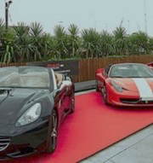

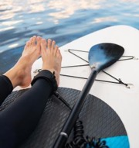

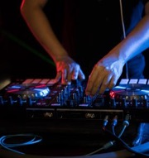
Alo Spain DMC
01
02
03
04
05
4X4 WINE CELLAR VISITS
URBAN OR CIRCUIT GT CARS DRIVING
FOOTBALL TICKETS
SHOPPING EXCURSIONS
BRANDING
ENTERTAINMENT
ACTIVITIES
Cultural activities, leisure, team building, sports…tailor made according to your goals.
FLAMENCO DANCE
AND MUSIC WORKSHOPS
WATERSPORTS ACTIVITIES
MUSEUM VISITS UNDER CLOSED DOORS
SAILING EXCURSIONS
DANCE SHOWS
MUSICAL RECEPTION
EBIKE
TOURS
NIGHT CLUB CUSTOMIZED SHOWS
TEAM BUILDINGS
GO CAR TOURS (TALKING CARS)
LIVE BANDS
RUMBA
AND FLAMENCO PRIVATE SHOWS

Slide 25
Alo Spain DMC
01
02
03
04
05
4X4 WINE CELLAR VISITS
URBAN OR CIRCUIT GT CARS DRIVING
FOOTBALL TICKETS
SHOPPING EXCURSIONS
ACTIVITIES
Cultural activities, leisure, team building, sports…tailor made according to your goals.
FLAMENCO DANCE
AND MUSIC WORKSHOPS
WATERSPORTS ACTIVITIES
MUSEUM VISITS UNDER CLOSED DOORS
SAILING EXCURSIONS
EBIKE
TOURS
NIGHT CLUB CUSTOMIZED SHOWS
TEAM BUILDINGS
GO CAR TOURS (TALKING CARS)

Slide 26
04
REFERENCES

Slide 27

Alo Spain DMC
VB Group
Thanks again for everything,
all last-minute changes and special requests. All worked very well and we are happy.
J.H - Marketing Communication Specialist
On behalf of Delonghi Egypt, I would like
to express my sincere appreciation for all
the professional input we got from ALO Spain
Services were really outstanding that results
in the success of the event that was really appreciated by all Delonghi’s guests.
Nader Samy - Managing Director Pioneer Events
I met ALO Spain for the first time in 2014 when I was working as the cruise manager for a Turkish tour operator. That time I needed a partner in Spain and through some references we got in contact. Now 10 years later and having my own business we are still having a great cooperation together. Nothing has changed in the past 10 years and the services provided have always been excellent. While speaking about excellent service I need to mention the names of Marion Richard (DMC Director) and Sandra Ramon (Alo Congress Managing Director). Both of them (Sandra, 2014-2020 and Marion 2014-present) have always been great and supportive. If it isn't because of me, it's because of them why we have such a great cooperation with ALO :))) Jokes aside, it's a pleasure working with Alo Spain. Hope for many years to come!
Onur Abacı - Owner - Touron
It was a great experience to work with Alo Spain , Marion was so cooperative, professional, facilitate everything and so patient to answer all questions and discuss every single detail and following up with her team to make sure that we received the highest standard of service. Thank you for everything and hope to have more and more successful groups in Spain.
Dina Elsayed - Key Account Manager World Round Travel
I have been working with Alo Spain DMC for almost 10 years.
We have organized more than 100 groups from 5 pax to
500 pax. They are more than a dmc.Well experienced game changers and high level solution maker. You dont fell like working with another dmc DMC in spain after you experience them.
Gökhan Çoktan - Outgoing Events and Incentive Manager
We were very pleased with many of the operations we carried out in Spain. They always work solution-oriented. They respond quickly and their operational capabilities are very high. I would definitely recommend you to work with them.
My Experience is super Positive ! Alo Spain has been game changer for our business since our partnership began in 2017, we have been able to grow tremendously and rely on, they have the full services
of Travel agency and back up of a Reputable Company.
During our long- lasting relationship with ALO Spain, we mostly appreciate: the perfect services, the best deals in the market, the wide choices in the shortest possible time to our clients , as well
as professional services assistance on ground 24x7.
Thank you so much for all you did for GLC group. 😊
Peter Haleem -Assistant Manager –Outbound Operation
01
02
03
04
05
06
07

Slide 28
Alo Spain DMC
VB Group
Thanks again for everything,
all last-minute changes and special requests. All worked very well and we are happy.
J.H - Marketing Communication Specialist
On behalf of Delonghi Egypt, I would like
to express my sincere appreciation for all
the professional input we got from ALO Spain
Services were really outstanding that results
in the success of the event that was really appreciated by all Delonghi’s guests.
Nader Samy - Managing Director Pioneer Events
I met ALO Spain for the first time in 2014 when I was working as the cruise manager for a Turkish tour operator. That time I needed a partner in Spain and through some references we got in contact. Now 10 years later and having my own business we are still having a great cooperation together. Nothing has changed in the past 10 years and the services provided have always been excellent. While speaking about excellent service I need to mention the names of Marion Richard (DMC Director) and Sandra Ramon (Alo Congress Managing Director). Both of them (Sandra, 2014-2020 and Marion 2014-present) have always been great and supportive. If it isn't because of me, it's because of them why we have such a great cooperation with ALO :))) Jokes aside, it's a pleasure working with Alo Spain. Hope for many years to come!
Onur Abacı - Owner - Touron
It was a great experience to work with Alo Spain , Marion was so cooperative, professional, facilitate everything and so patient to answer all questions and discuss every single detail and following up with her team to make sure that we received the highest standard of service. Thank you for everything and hope to have more and more successful groups in Spain.
Dina Elsayed - Key Account Manager World Round Travel
I have been working with Alo Spain DMC for almost 10 years.
We have organized more than 100 groups from 5 pax to
500 pax. They are more than a dmc.Well experienced game changers and high level solution maker. You dont fell like working with another dmc DMC in spain after you experience them.
Gökhan Çoktan - Outgoing Events and Incentive Manager
We were very pleased with many of the operations we carried out in Spain. They always work solution-oriented. They respond quickly and their operational capabilities are very high. I would definitely recommend you to work with them.
My Experience is super Positive ! Alo Spain has been game changer for our business since our partnership began in 2017, we have been able to grow tremendously and rely on, they have the full services
of Travel agency and back up of a Reputable Company.
During our long- lasting relationship with ALO Spain, we mostly appreciate: the perfect services, the best deals in the market, the wide choices in the shortest possible time to our clients , as well
as professional services assistance on ground 24x7.
Thank you so much for all you did for GLC group. 😊
Peter Haleem -Assistant Manager –Outbound Operation
01
02
03
04
05
06
07

Slide 29
Alo Spain DMC
VB Group
Thanks again for everything,
all last-minute changes and special requests. All worked very well and we are happy.
J.H - Marketing Communication Specialist
On behalf of Delonghi Egypt, I would like
to express my sincere appreciation for all
the professional input we got from ALO Spain
Services were really outstanding that results
in the success of the event that was really appreciated by all Delonghi’s guests.
Nader Samy - Managing Director Pioneer Events
I met ALO Spain for the first time in 2014 when I was working as the cruise manager for a Turkish tour operator. That time I needed a partner in Spain and through some references we got in contact. Now 10 years later and having my own business we are still having a great cooperation together. Nothing has changed in the past 10 years and the services provided have always been excellent. While speaking about excellent service I need to mention the names of Marion Richard (DMC Director) and Sandra Ramon (Alo Congress Managing Director). Both of them (Sandra, 2014-2020 and Marion 2014-present) have always been great and supportive. If it isn't because of me, it's because of them why we have such a great cooperation with ALO :))) Jokes aside, it's a pleasure working with Alo Spain. Hope for many years to come!
Onur Abacı - Owner - Touron
It was a great experience to work with Alo Spain , Marion was so cooperative, professional, facilitate everything and so patient to answer all questions and discuss every single detail and following up with her team to make sure that we received the highest standard of service. Thank you for everything and hope to have more and more successful groups in Spain.
Dina Elsayed - Key Account Manager World Round Travel
I have been working with Alo Spain DMC for almost 10 years.
We have organized more than 100 groups from 5 pax to
500 pax. They are more than a dmc.Well experienced game changers and high level solution maker. You dont fell like working with another dmc DMC in spain after you experience them.
Gökhan Çoktan - Outgoing Events and Incentive Manager
We were very pleased with many of the operations we carried out in Spain. They always work solution-oriented. They respond quickly and their operational capabilities are very high. I would definitely recommend you to work with them.
My Experience is super Positive ! Alo Spain has been game changer for our business since our partnership began in 2017, we have been able to grow tremendously and rely on, they have the full services
of Travel agency and back up of a Reputable Company.
During our long- lasting relationship with ALO Spain, we mostly appreciate: the perfect services, the best deals in the market, the wide choices in the shortest possible time to our clients , as well
as professional services assistance on ground 24x7.
Thank you so much for all you did for GLC group. 😊
Peter Haleem -Assistant Manager –Outbound Operation
01
02
03
04
05
06
07

Slide 30
Alo Spain DMC
VB Group
Thanks again for everything,
all last-minute changes and special requests. All worked very well and we are happy.
J.H - Marketing Communication Specialist
On behalf of Delonghi Egypt, I would like
to express my sincere appreciation for all
the professional input we got from ALO Spain
Services were really outstanding that results
in the success of the event that was really appreciated by all Delonghi’s guests.
Nader Samy - Managing Director Pioneer Events
I met ALO Spain for the first time in 2014 when I was working as the cruise manager for a Turkish tour operator. That time I needed a partner in Spain and through some references we got in contact. Now 10 years later and having my own business we are still having a great cooperation together. Nothing has changed in the past 10 years and the services provided have always been excellent. While speaking about excellent service I need to mention the names of Marion Richard (DMC Director) and Sandra Ramon (Alo Congress Managing Director). Both of them (Sandra, 2014-2020 and Marion 2014-present) have always been great and supportive. If it isn't because of me, it's because of them why we have such a great cooperation with ALO :))) Jokes aside, it's a pleasure working with Alo Spain. Hope for many years to come!
Onur Abacı - Owner - Touron
It was a great experience to work with Alo Spain , Marion was so cooperative, professional, facilitate everything and so patient to answer all questions and discuss every single detail and following up with her team to make sure that we received the highest standard of service. Thank you for everything and hope to have more and more successful groups in Spain.
Dina Elsayed - Key Account Manager World Round Travel
I have been working with Alo Spain DMC for almost 10 years.
We have organized more than 100 groups from 5 pax to
500 pax. They are more than a dmc.Well experienced game changers and high level solution maker. You dont fell like working with another dmc DMC in spain after you experience them.
Gökhan Çoktan - Outgoing Events and Incentive Manager
We were very pleased with many of the operations we carried out in Spain. They always work solution-oriented. They respond quickly and their operational capabilities are very high. I would definitely recommend you to work with them.
My Experience is super Positive ! Alo Spain has been game changer for our business since our partnership began in 2017, we have been able to grow tremendously and rely on, they have the full services
of Travel agency and back up of a Reputable Company.
During our long- lasting relationship with ALO Spain, we mostly appreciate: the perfect services, the best deals in the market, the wide choices in the shortest possible time to our clients , as well
as professional services assistance on ground 24x7.
Thank you so much for all you did for GLC group. 😊
Peter Haleem -Assistant Manager –Outbound Operation
01
02
03
04
05
06
07

Slide 31
Alo Spain DMC
VB Group
Thanks again for everything,
all last-minute changes and special requests. All worked very well and we are happy.
J.H - Marketing Communication Specialist
On behalf of Delonghi Egypt, I would like
to express my sincere appreciation for all
the professional input we got from ALO Spain
Services were really outstanding that results
in the success of the event that was really appreciated by all Delonghi’s guests.
Nader Samy - Managing Director Pioneer Events
I met ALO Spain for the first time in 2014 when I was working as the cruise manager for a Turkish tour operator. That time I needed a partner in Spain and through some references we got in contact. Now 10 years later and having my own business we are still having a great cooperation together. Nothing has changed in the past 10 years and the services provided have always been excellent. While speaking about excellent service I need to mention the names of Marion Richard (DMC Director) and Sandra Ramon (Alo Congress Managing Director). Both of them (Sandra, 2014-2020 and Marion 2014-present) have always been great and supportive. If it isn't because of me, it's because of them why we have such a great cooperation with ALO :))) Jokes aside, it's a pleasure working with Alo Spain. Hope for many years to come!
Onur Abacı - Owner - Touron
It was a great experience to work with Alo Spain , Marion was so cooperative, professional, facilitate everything and so patient to answer all questions and discuss every single detail and following up with her team to make sure that we received the highest standard of service. Thank you for everything and hope to have more and more successful groups in Spain.
Dina Elsayed - Key Account Manager World Round Travel
I have been working with Alo Spain DMC for almost 10 years.
We have organized more than 100 groups from 5 pax to
500 pax. They are more than a dmc.Well experienced game changers and high level solution maker. You dont fell like working with another dmc DMC in spain after you experience them.
Gökhan Çoktan - Outgoing Events and Incentive Manager
We were very pleased with many of the operations we carried out in Spain. They always work solution-oriented. They respond quickly and their operational capabilities are very high. I would definitely recommend you to work with them.
My Experience is super Positive ! Alo Spain has been game changer for our business since our partnership began in 2017, we have been able to grow tremendously and rely on, they have the full services
of Travel agency and back up of a Reputable Company.
During our long- lasting relationship with ALO Spain, we mostly appreciate: the perfect services, the best deals in the market, the wide choices in the shortest possible time to our clients , as well
as professional services assistance on ground 24x7.
Thank you so much for all you did for GLC group. 😊
Peter Haleem -Assistant Manager –Outbound Operation
01
02
03
04
05
06
07

Slide 32
Alo Spain DMC
VB Group
Thanks again for everything,
all last-minute changes and special requests. All worked very well and we are happy.
J.H - Marketing Communication Specialist
On behalf of Delonghi Egypt, I would like
to express my sincere appreciation for all
the professional input we got from ALO Spain
Services were really outstanding that results
in the success of the event that was really appreciated by all Delonghi’s guests.
Nader Samy - Managing Director Pioneer Events
I met ALO Spain for the first time in 2014 when I was working as the cruise manager for a Turkish tour operator. That time I needed a partner in Spain and through some references we got in contact. Now 10 years later and having my own business we are still having a great cooperation together. Nothing has changed in the past 10 years and the services provided have always been excellent. While speaking about excellent service I need to mention the names of Marion Richard (DMC Director) and Sandra Ramon (Alo Congress Managing Director). Both of them (Sandra, 2014-2020 and Marion 2014-present) have always been great and supportive. If it isn't because of me, it's because of them why we have such a great cooperation with ALO :))) Jokes aside, it's a pleasure working with Alo Spain. Hope for many years to come!
Onur Abacı - Owner - Touron
It was a great experience to work with Alo Spain , Marion was so cooperative, professional, facilitate everything and so patient to answer all questions and discuss every single detail and following up with her team to make sure that we received the highest standard of service. Thank you for everything and hope to have more and more successful groups in Spain.
Dina Elsayed - Key Account Manager World Round Travel
I have been working with Alo Spain DMC for almost 10 years.
We have organized more than 100 groups from 5 pax to
500 pax. They are more than a dmc.Well experienced game changers and high level solution maker. You dont fell like working with another dmc DMC in spain after you experience them.
Gökhan Çoktan - Outgoing Events and Incentive Manager
We were very pleased with many of the operations we carried out in Spain. They always work solution-oriented. They respond quickly and their operational capabilities are very high. I would definitely recommend you to work with them.
My Experience is super Positive ! Alo Spain has been game changer for our business since our partnership began in 2017, we have been able to grow tremendously and rely on, they have the full services
of Travel agency and back up of a Reputable Company.
During our long- lasting relationship with ALO Spain, we mostly appreciate: the perfect services, the best deals in the market, the wide choices in the shortest possible time to our clients , as well
as professional services assistance on ground 24x7.
Thank you so much for all you did for GLC group. 😊
Peter Haleem -Assistant Manager –Outbound Operation
01
02
03
04
05
06
07

Slide 33
Alo Spain DMC
VB Group
Thanks again for everything,
all last-minute changes and special requests. All worked very well and we are happy.
J.H - Marketing Communication Specialist
On behalf of Delonghi Egypt, I would like
to express my sincere appreciation for all
the professional input we got from ALO Spain
Services were really outstanding that results
in the success of the event that was really appreciated by all Delonghi’s guests.
Nader Samy - Managing Director Pioneer Events
I met ALO Spain for the first time in 2014 when I was working as the cruise manager for a Turkish tour operator. That time I needed a partner in Spain and through some references we got in contact. Now 10 years later and having my own business we are still having a great cooperation together. Nothing has changed in the past 10 years and the services provided have always been excellent. While speaking about excellent service I need to mention the names of Marion Richard (DMC Director) and Sandra Ramon (Alo Congress Managing Director). Both of them (Sandra, 2014-2020 and Marion 2014-present) have always been great and supportive. If it isn't because of me, it's because of them why we have such a great cooperation with ALO :))) Jokes aside, it's a pleasure working with Alo Spain. Hope for many years to come!
Onur Abacı - Owner - Touron
It was a great experience to work with Alo Spain , Marion was so cooperative, professional, facilitate everything and so patient to answer all questions and discuss every single detail and following up with her team to make sure that we received the highest standard of service. Thank you for everything and hope to have more and more successful groups in Spain.
Dina Elsayed - Key Account Manager World Round Travel
I have been working with Alo Spain DMC for almost 10 years.
We have organized more than 100 groups from 5 pax to
500 pax. They are more than a dmc.Well experienced game changers and high level solution maker. You dont fell like working with another dmc DMC in spain after you experience them.
Gökhan Çoktan - Outgoing Events and Incentive Manager
We were very pleased with many of the operations we carried out in Spain. They always work solution-oriented. They respond quickly and their operational capabilities are very high. I would definitely recommend you to work with them.
My Experience is super Positive ! Alo Spain has been game changer for our business since our partnership began in 2017, we have been able to grow tremendously and rely on, they have the full services
of Travel agency and back up of a Reputable Company.
During our long- lasting relationship with ALO Spain, we mostly appreciate: the perfect services, the best deals in the market, the wide choices in the shortest possible time to our clients , as well
as professional services assistance on ground 24x7.
Thank you so much for all you did for GLC group. 😊
Peter Haleem -Assistant Manager –Outbound Operation
01
02
03
04
05
06
07

Slide 34
THANKS FOR READING!
Marion Richard – Director
mrichard@alospain.com
+34 619 38 98 80
DMC
dmc@alospain.com
+ 93 439 35 94

